Slide 1
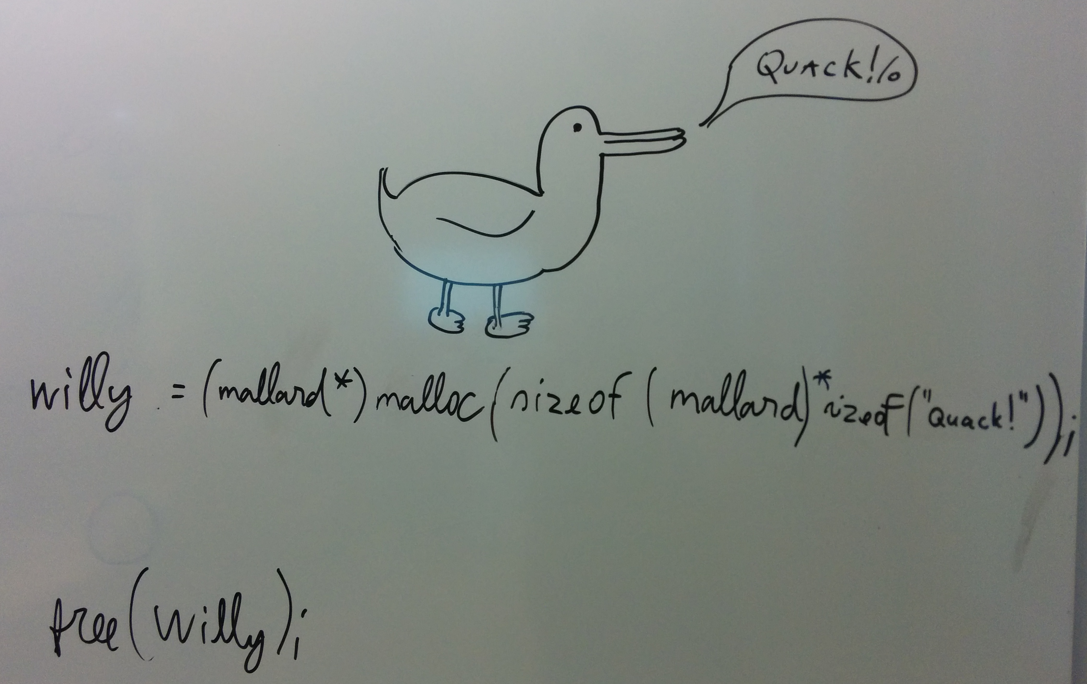

Slide 2
Memory management v2
calloc()

Slide 3
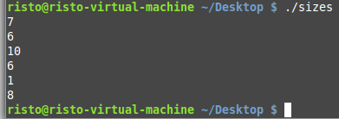
sizeof() vs strlen()
#include <stdio.h>
#include <string.h>
int main(void)
{
char arr[10] = "Hello!";
printf("%d\n", sizeof("Hello!"));
printf("%d\n", strlen("Hello!"));
printf("%d\n", sizeof(arr));
printf("%d\n", strlen(arr));
printf("%d\n", sizeof(char));
printf("%d\n", sizeof(char *));
return 0;
}

Slide 4
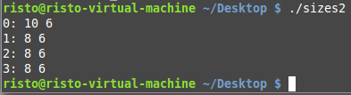
sizeof() vs strlen()
void Print1(char *arr){
printf("1: %d %d\n", sizeof(arr), strlen(arr));
}
void Print2(char arr[]){
printf("2: %d %d\n", sizeof(arr), strlen(arr));
}
void Print3(char arr[10]){
printf("3: %d %d\n", sizeof(arr), strlen(arr));
}
int main(void){
char arr[10] = "Hello!";
printf("0: %d %d\n", sizeof(arr), strlen(arr));
Print1(arr); Print2(arr); Print3(arr);
return 0;
}

Slide 5
Workflow reminder
Declare a pointer
Allocate memory
Check that the allocation didn’t fail
Do all of the processing needed
Free the memory
Check using valgrind that there were no memory leaks

Slide 6
calloc()
calloc() function prototype: void* calloc (size_t num, size_t size);
Return type (void *) - void pointer to the beginning of the allocated block
1. parameter num - (size_t) – how many elements
2. parameter size - (size_t) – how many bytes for each element
Compared to malloc(), the memory will be zero-initialized In code: pNum = (int*)calloc(n, sizeof(int));

Slide 7
Sample: calloc
#include <stdio.h>
#include <stdlib.h>
#define N 5
int main(void)
{
int *pNumbers, i;
pNumbers = (int*)calloc(N, sizeof(int));
if (pNumbers == NULL)
{
printf("Not enough memory!\n");
exit(1);
}
for (i = 0; i < N; i++)
printf("%d\n", *(pNumbers + i));
free(pNumbers);
return 0;
}

Slide 8
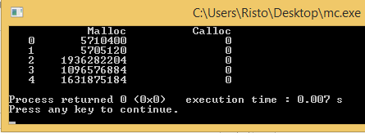
Sample: Initial values for memory
#include <stdio.h>
#include <stdlib.h>
#define N 5
int main(void)
{
int *pArr1 = (int*)malloc(N * sizeof(int));
int *pArr2 = (int*)calloc(N, sizeof(int));
int i;
printf("\t%10s\t%10s\n", "Malloc", "Calloc");
for (i = 0; i < N; i++)
printf("%4d\t%10d\t%10d\n", i, *(pArr1 + i), *(pArr2 + i));
free(pArr1);
free(pArr2);
return 0;
}

Slide 9
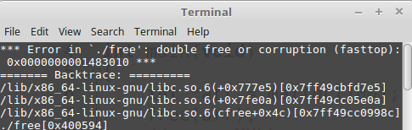
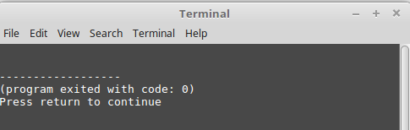
Sample: defensive programming
#include <stdio.h>
#include <stdlib.h>
int main(void)
{
int *arr = malloc(100);
free(arr);
free(arr);
return 0;
}
#include <stdio.h>
#include <stdlib.h>
int main(void)
{
int *arr = malloc(100);
free(arr);
arr = NULL;
free(arr);
return 0;
}

Slide 10
Sample: defensive programming
**arr 0x00AAF0
#include <stdio.h>
#include <stdlib.h>
void SafeFree(void **arr);
int main(void)
{
int *arr = malloc(100);
SafeFree((void *)&arr);
return 0;
}
void SafeFree(void **arr)
{
if (arr != NULL && *arr != NULL)
{
free(*arr);
*arr = NULL;
}
}
0x00AAEC
*arr 0x00AAF4
0x00AAF0
*arr[0]
*arr[1]
0x0FFFF4
0x0FFFF8

Slide 11
Sample: double pointer for allocation
#include <stdio.h>
#include <stdlib.h>
int AllocateData(int **data);
int main(void)
{
int *vals;
int length = AllocateData(&vals);
// use data until needed
printf("Allocated for %d\n", length);
free(vals);
return 0;
}
int AllocateData(int **data)
{
int n;
scanf("How many integers to allocate?\n");
scanf("%d", &n);
*data = malloc(sizeof(int) * n); // don't forget memory check!
return n
}

Slide 12
Allocation memory to structure members (partial, single structure, not an array!)
Structure member will be a pointer
typedef struct
{
char *name;
} identity;
Allocation to the structure member is done separately.
identity *pStr;
pStr = (identity*)malloc(sizeof(identity));
pStr->name = (char *)malloc((strlen(buf) + 1) * sizeof(char));
Everything that was allocated also needs to be freed
free(pStr->name);
free(pStr);

Slide 13
Lab task (requirements on next slide)
Read N records from a file into a structure array. N is the first number in the file.
Structure of a record: Identification number, first and last name, age
Find which age groups are the largest.
Display the size of each age group
Display the largest group(s)
There may be more than one largest group
Age group size is 10 years (0 – 9, 10 – 19, 20 – 29, …, 120 – 129)
Check for memory problems with valgrind!

Slide 14
Requirements
Allocations should be precise for both the struct array and the names inside of the struct
Buffers for temporarily storing data should be fixed size
Don’t forget, plenty of functions
Including for reading the file (return your allocated struct or pass a double pointer)
Create a function that will free the entire data struct. You should call it both before the program ends and when allocation fails in the middle of reading a long file. Remember, freeing a NULL pointer won’t crash the program if you don’t know which fields are allocated (e.g. were first and last name allocated or not)
Make sure any invalid pointer address will be set to NULL

Slide 15
Advanced
Advanced task 1: Allow custom age group size in years. User will specify size upon launching the program.
Advanced task 2: Draw a bar graph of the age distribution.
Can be either horizontal or vertical.
Make sure it is sensible both if everyone is in the same age group or equally distributed, as well as if the file contains 10, 100 or 100 000 people.
Extra task: Picture on the first slide:
Make the text from the picture on the first slide compile and run without any warnings or errors.
The program must output the message sent by the duck using the help from willy.

